Slide 1

St. Charles Parish
Personnel Presentation
to the Council
May 4, 2026
Dayna Parker, Personnel Officer

Slide 2

Personnel Staff Primary Functions
Dayna Parker, Personnel Officer
  Civil Service System Interpretation and Administration
  Advisor to Parish Departments/Administration/Employees on Personnel Related Topics
  Local, State and Federal Law Compliance in Relation to Personnel
  Employee Relations/Grievance Process
  Employee Training and Wellness Program Administration
Kayla Petit, Personnel Generalist
  Employment Process which includes Recruitment, Qualifying, Testing, and On-boarding
  Drug Testing which includes Pre-employment, Random, Probable Cause and Post Accident
Renee Agurcia, Benefits Specialist
  Employee Benefits Coordination and Administration: Group Health, Dental, Vision, Life & Disability Insurance
  Retirement System Administration
Kim Perret, Personnel Specialist
  Deferred Compensation
  FMLA
  Payroll Change Transactions and Employee Data Management
  Workman’s Compensation and Unemployment Reporting and Administration
  Wellness Program

Slide 3
Employment Statistics
668 Current
680 in 2025
PAYROLL
HEADCOUNT*
Other
Part-time
Appointed Staff
* Headcount – April 30, 2026

Slide 4
Hiring Statistics
2025 Hiring
2026 Hiring
Currently through April 2026
17 External
44%
22 Internal
56%
113
Jobs Filled
59 External
52%
54 Internal
48%
Personnel staff is attending Career Fairs to share about St. Charles Parish career opportunities.

Slide 5
Retirements
16
Retirements
14
DROP
3
Retirements
0
Disability
Retirement
0
Disability
Retirements
DROP (Deferred Retirement Option Plan)
The plan allows the pension benefit that is accrued at the time of entry into DROP to be calculated and to accumulate with the retirement system while the DROP participant continues to work, freezing the future retirement benefit at retirement. The pension benefit is calculated as if the member were actually retiring

Slide 6



Personnel Activities
July 2026 Benefits Renewal
We will continue to offer both an HMO and PPO plan through Louisiana Blue with the same coverage as last year with no increase in premiums.
Dental, Vision, Life and Disability Insurance will remain with Mutual of Omaha with no change in coverage or premiums.
Flexible Spending Account open enrollment – end of year.
  FSA – Flexible Spending Account: 59 Enrolled
  DCFSA – Dependent Care Flexible Spending Account: 4 Enrolled
Benefit | Provider
Health | Louisiana Blue
Dental | Mutual of Omaha
Vision | Mutual of Omaha
Life & AD&D | Mutual of Omaha
Short & Long Term Disability | Mutual of Omaha
Flexible Spending Account | Health Equity
Current Preferred Rate Premiums
Plan | Employee | Parish | Total
HMO –Single | $78.49 | $802.07 | $880.56
HMO – Family | $216.74 | $2,116.74 | $2,333.48
PPO – Single | $89.11 | $807.22 | $896.33
PPO - Family | $244.88 | $2,130.37 | $2,375.25

Slide 7
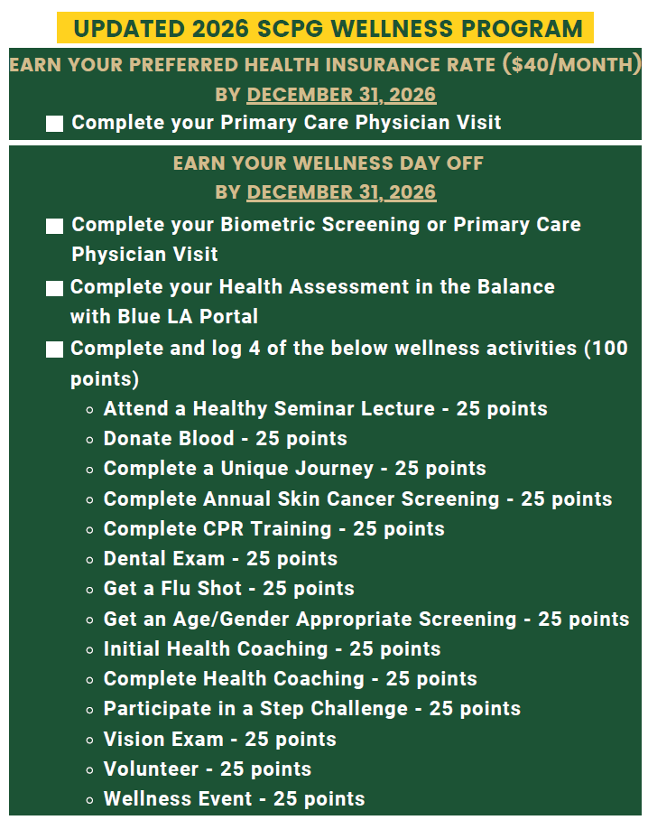
Personnel Activities
Wellness Program
  Strong emphasis on preventive care:
    Annual visit with primary care physician (PCP)
    Support and improve employee health through early detection and prevention.
    PCP visits help identify health risks earlier, manage chronic conditions, and reduce avoidable emergency and high-cost care.
    Leads to better health outcomes and more predictable healthcare costs, which directly impacts our claims & ability to offer competitive benefits .
  Managing health insurance claims to support more stable renewal costs
    Final Engagement #s for 2025:
    Preferred Health Insurance Premium: 414
      (323 in 2024)
    Wellness Day Off: 116
      (99 in 2024)
    Health Coaching: 22
      (11 in 2024)
      Currently have 45 engaged
Notes:
Dana Frank, very visible and more accessible to employees

Slide 8
Personnel Activities
Outstanding Achievement Merit Increase
  Eligibility:
Employed as a Civil Service employee for at least one year.
Have an annual performance rating of Exceeds Expectations for prior performance evaluation.
Have not received the outstanding achievement merit within 3 years.
Employee must not be on a final warning or performance improvement plan.
  What is it?
  Additional opportunity to reward outstanding achievement by an employee.
  Independent of our annual performance evaluation process.
  Full step (equivalent to a 3%) increase on the pay plan within their current pay grade.
  What is the Process?
  Department Directors will submit a written request and justification to the Personnel Officer any time throughout the year.
  If eligibility requirements are met, the Personnel Officer will present the request and justification to the Parish Executive Staff and the Parish President for review and consideration.
  Examples of justification may include:
    Extraordinary results, leadership and influence, innovation and problem solving, ownership and accountability, collaboration and team impact, professional development and growth, or community and organizational impact.

Slide 9
Personnel Activities
Civil Service Awards
  Sixty-nine employees were honored in March for their years of service in 2025.
Laci Morris, Community Center Coordinator, was recognized as the 2025 Employee of the Year.
Dwayne Williams, Waterworks Distribution Lead, was recognized as the 2025 Employee of the Year.
Jimmy Breaux Outstanding Achievement Award
  In honor of the late James “Jimmy” Breaux who served as a Civil Service Board Member for 40 years, we established the JIMMY BREAUX OUTSTANDING ACHIEVEMENT AWARD.
  This award will recognize an employee or employees that demonstrate an exemplary standard of work during the year.
    Allison & Brett Badgerow
Their dedication, leadership, and commitment to the success of our 2025 United Way Campaign.

Slide 10
Civil Service Board
Regmon Chaney
(Chair)
Patrick O’Malley
(Vice Chair)
Sara Champion
(Member)
Jim Carlson
(Member)
Brett Terrebonne
(Member)
  Five Civil Service Meetings have been held. *
  Agenda items included:
Personnel updates
Offers made above entry rates
Two employee upgrades
Five new job descriptions
CS Board Chair & Vice Chair
Job description changes for Econ. Dev. organizational restructure
Extension from Civil Service
2026 Holiday Schedules
2026 Civil Service Meeting Schedule
Civil Service Rules & Regulations changes:
  Section 7.08 Compensatory Leave
  Section 4.05.1 Outstanding Achievement Merit Increase
* Includes agenda items from Civil Service Meetings since last annual report: June 2025 – April 2026

Slide 11
Thank you for your time.

