Slide 1
A Year of Results in
Public Procurement
OFFICE OF PROCUREMENT
Efficient, Transparent and Responsible Procurement
St. Charles Parish Council| 2025 Fiscal Year in Review

Slide 2
Departments/Agencies We Support
Public Works
Wastewater
Waterworks
Parks & Recreation
Animal Control
Emergency Preparedness
Planning & Zoning
Community Services
Parish President’s Office
Economic Development &
Tourism
Public Information Office
Government Buildings
GIS
IT
Finance
Personnel
Grants
Risk Management
Legal Department
WIA
Council Office
Courts
Coroner’s Office
Assessor’s Office
Registrar of Voter’s Office
LSU Ag Center

Slide 3
2025 Procurement by the Numbers
6
9,673
Procurement Professionals
Purchase Orders Processed
36
$106,526
Publicly Advertised Bid Solicitations Issued
for Contract Execution
In Revenue returned from online auction sales

Slide 4
Improved Procurement Operations
Four process improvements
01
02
03
04
Tiered approvals
Standard templates
Digital intake
Live dashboards
Low-risk buys with a single authorization for fast and effective delivery of goods and services
Pre-approved solicitation and contract language reduce review and assembly time
One online request portal for solicitations and contract routing (OpenGov)
Added visibility for departments to track status of their solicitations, contract milestones (OpenGov)
Modernizing Through Technology

Slide 5
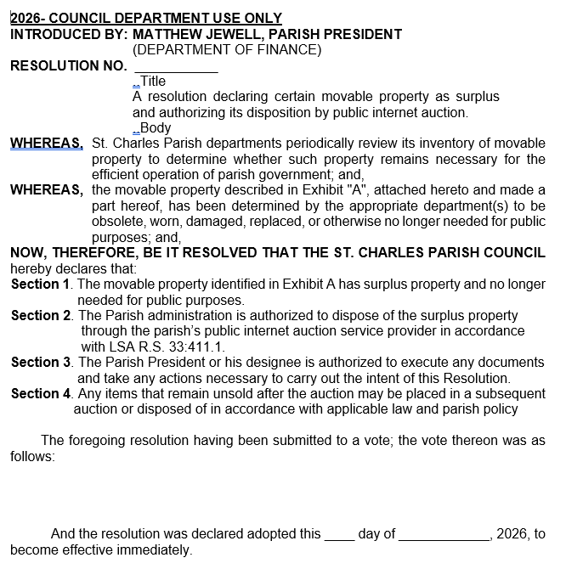
Surplus Auction Management
2026 Auction Revenue -
March 2026 - $90,970.67
May 2026 - $33,721.00
Next Auction taking place upon adoption of resolution

Slide 6

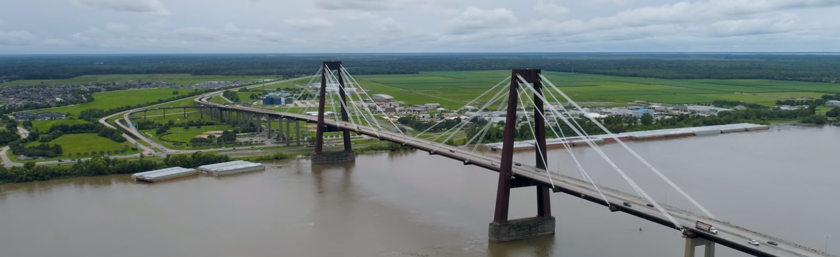
Procurement as a Partner

Slide 7
Questions? Comments?
Brenda Campos
Office 985-783-5000
OFFICE OF PROCUREMENT
Efficient, Transparent and Responsible Procurement
St. Charles Parish Council| 2025 Fiscal Year in Review

