Slide 1

St. Charles Parish Department of Planning and Zoning
Report to Parish Council
June 1, 2026
Director: Michael Albert, AICP, CFM

Slide 2
Department of Planning and Zoning
Land Use Planning
Coastal Zone/Floodplain Management
Code Enforcement Permitting

Slide 3

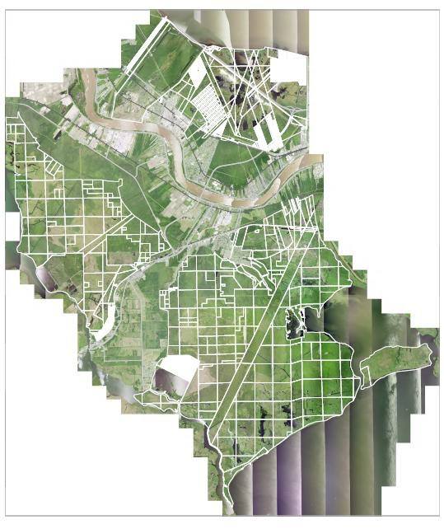
2025 Accomplishments
Lowered St. Charles Parish’s CRS rating to a “6” granting a 20% discount on full-risk premium policies.
Several updates to the Flood Damage Prevention Ordinance and Wetland Zoning District.
Drafting a substantial update to the Commercial Zoning District’s organization at the Commission’s request.
Re-established the Coastal Zone Advisory Committee and hired new staff to professionally guide the process.

Slide 4
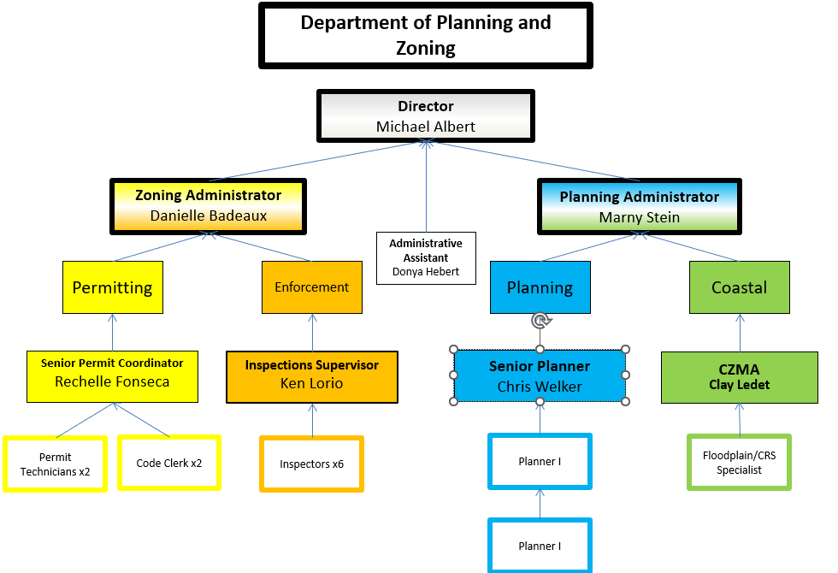
P&Z Organization

Slide 5

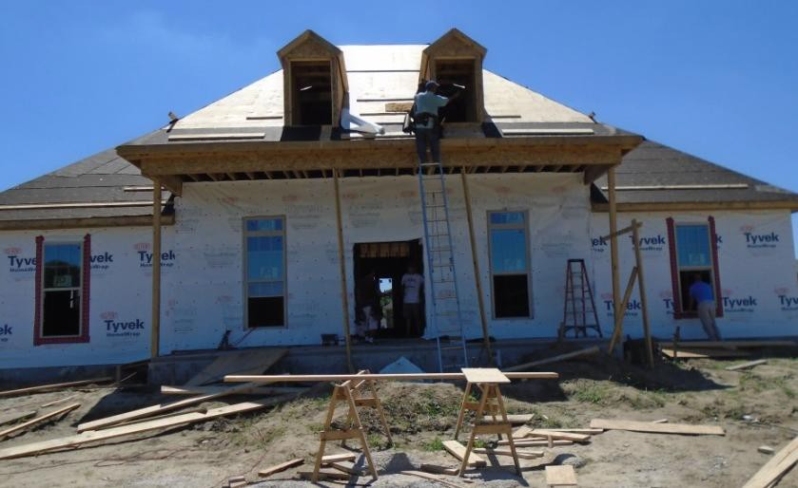

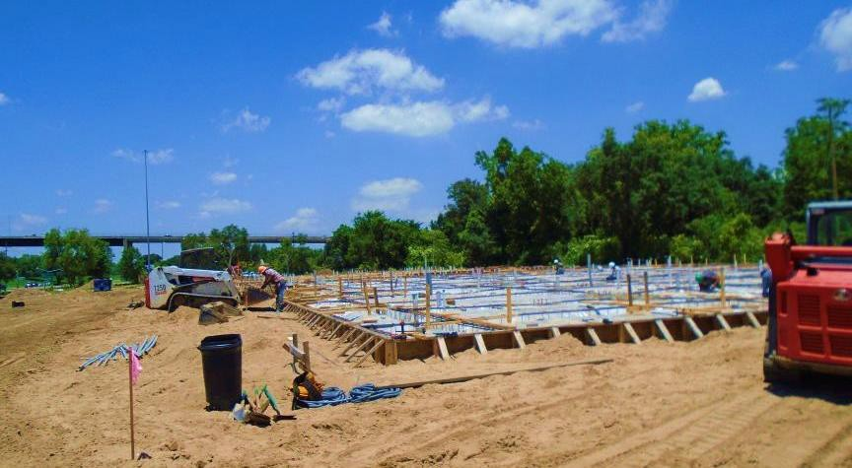
Construction Permitting
In 2025, the Department issued:
763 Total Permits
  100 New Homes
  125 Renovations
  30 New Commercial
  508 Trade
Trade, Renovation, and New Home Starts accounted for the highest volumes.
For the past 9 years, St. Charles Parish has chaired the Building Code Construction Council.

Slide 6
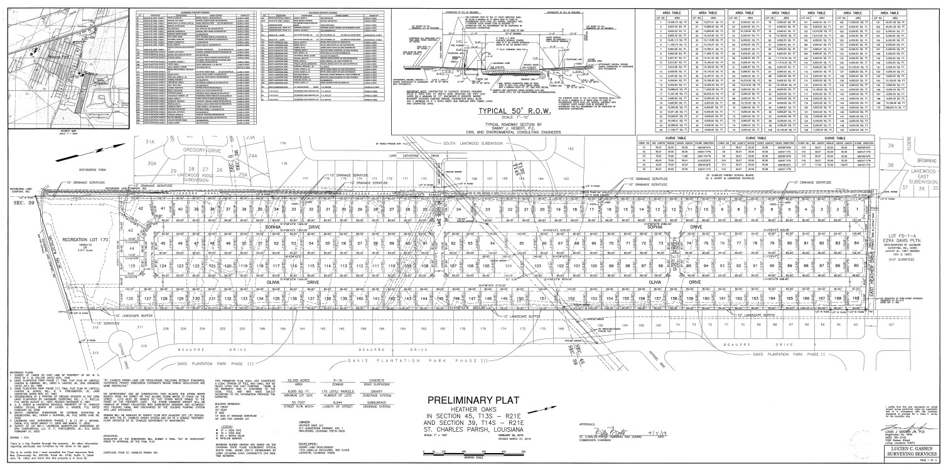
Major Subdivision Activity
Final Plats and Dedications:
Ashton Phase 2B, Lulling
  4 Residential Lots
Under Construction Review:
Ashton Patio Homes, Luling
  42 Residential Lots
Madison Place, Hahnville
  102 (62 in Phase 1) Residential Lots
Plantation Business Campus
Section 3
  17 Commercial/Industrial Lots

Slide 7


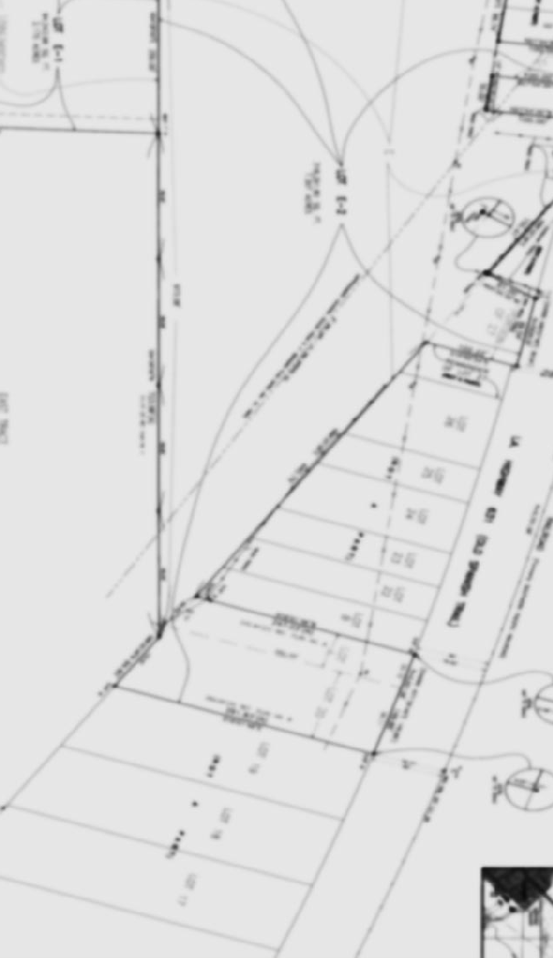
Land Use Applications
Applications | 2021 | 2022 | 2023 | 2024 | 2025
Rezone | 15 | 21 | 17 | 27 | 13
Resubdivision | 56 | 71 | 55 | 78 | 70
Special Permit Use | 10 | 17 | 6 | 8 | 7
Home Occupation | 75 | 61 | 77 | 17 | 58
Ordinance Revision | 9 | 3 | 2 | 3 | 9
Variances | 67 | 43 | 56 | 59 | 49

Slide 8
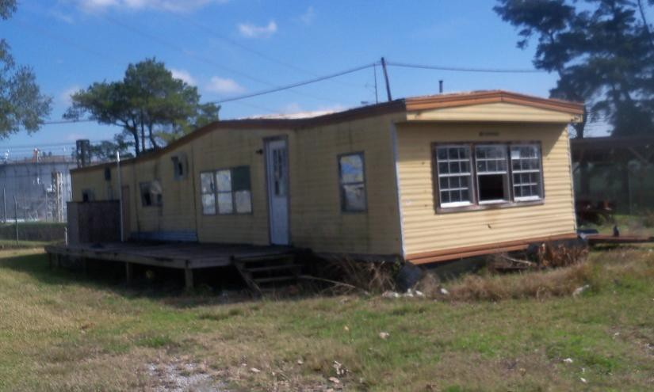

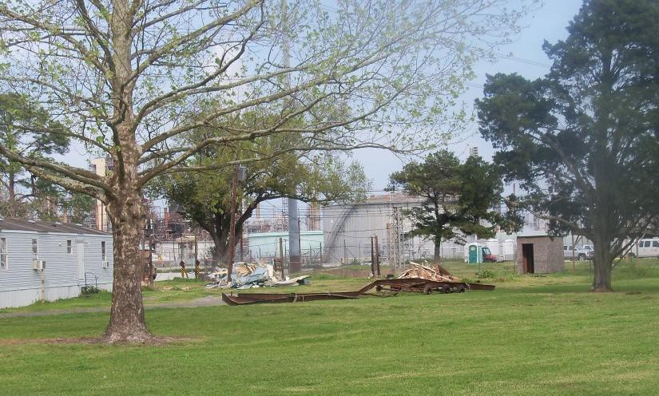
Code Enforcement
The Department’s Objective is to uphold the Parish’s community standards
by working with residents to achieve compliance.
Before
Permits Closed | 903
Permits Open (as of 12/31/21) | 444
Total Complaints Received | 134
Total Complaints Resolved | 869
Derelict vehicles tagged or removed | 79
Cases In Legal (as of 12/31/25) | 231
Grass violations resolved | 470
After

Slide 9
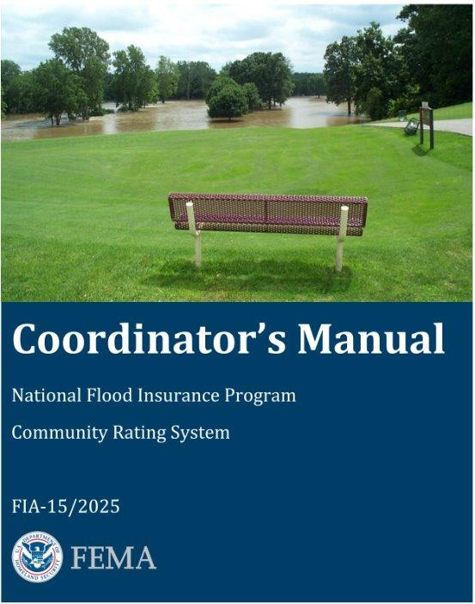
Floodplain Management
Began preparations for the 5-year CRS cycle.
Facilitated Ord. No 25-6-1 to increase the maximum square footage from 200 to 600 sq. ft. to allow wet floodproofing of residential accessory buildings. Wet flood proofing is a more affordable flood damage prevention treatment that allows accessory buildings to be placed closer to grade.
Began work on a Flood Insurance Coverage Improvement Plan and Natural Floodplain Functions Plan to improve our standing in the Community Rating System (CRS).
Completed a 5-year CRS Cycle with a score of 2022 which improved our rank to Class 6. Policies at the full risk premium should be receiving the resulting 20% premium discount in October 2026.
Began work on a 1-year Floodplain Management Planning effort to
improve the CRS rating further.

Slide 10


Floodplain Management Planning Timeline
Nov 2025 - Jan 2026
January - April 2026
May - July 2026
Aug - Oct 2026
End of 2026
Step 1, 2, 3
Steps 4, 5
Steps 6, 7
Step 8
Steps 9, 10
Set up 2 Committees; gather documents
Assess the flood hazard and impact
Set planning goals and mitigation activities
Draft Action Plan
Adopt the plan; implement, evaluate, revise
Technical Committee Meetings
Public Steering Committee Meetings
Public Information Activities
10

Slide 11

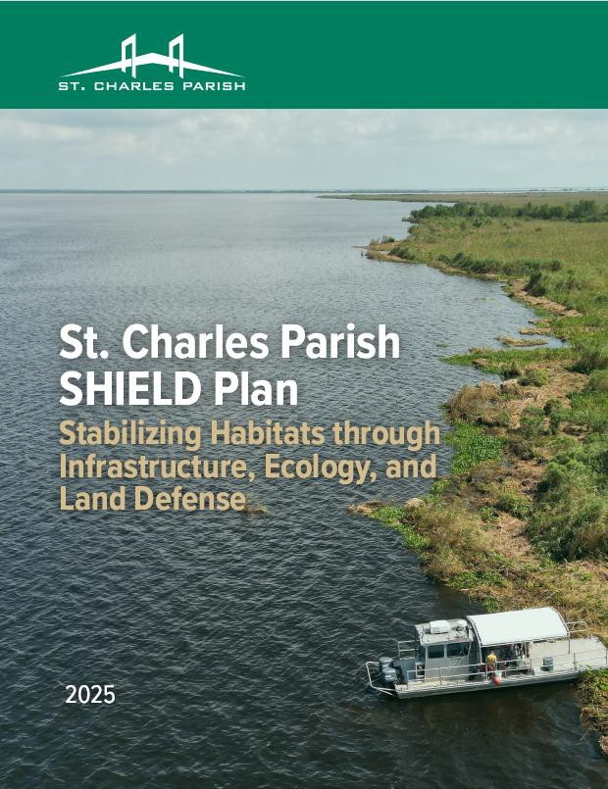
Coastal Zone
St. Charles’s Local Coastal Program went into effect late in 2017. In 2025 the Local Program processed 10 permits locally.
Reviewed, processed, and readied for adoption the SCP SHIELD Plan.
Updated our database to back-log over 60 previous applications.
Re-engaged with LDENR’s Office of Compliance to solidify our Local Coastal Program.
  So, what does that look like?

Slide 12
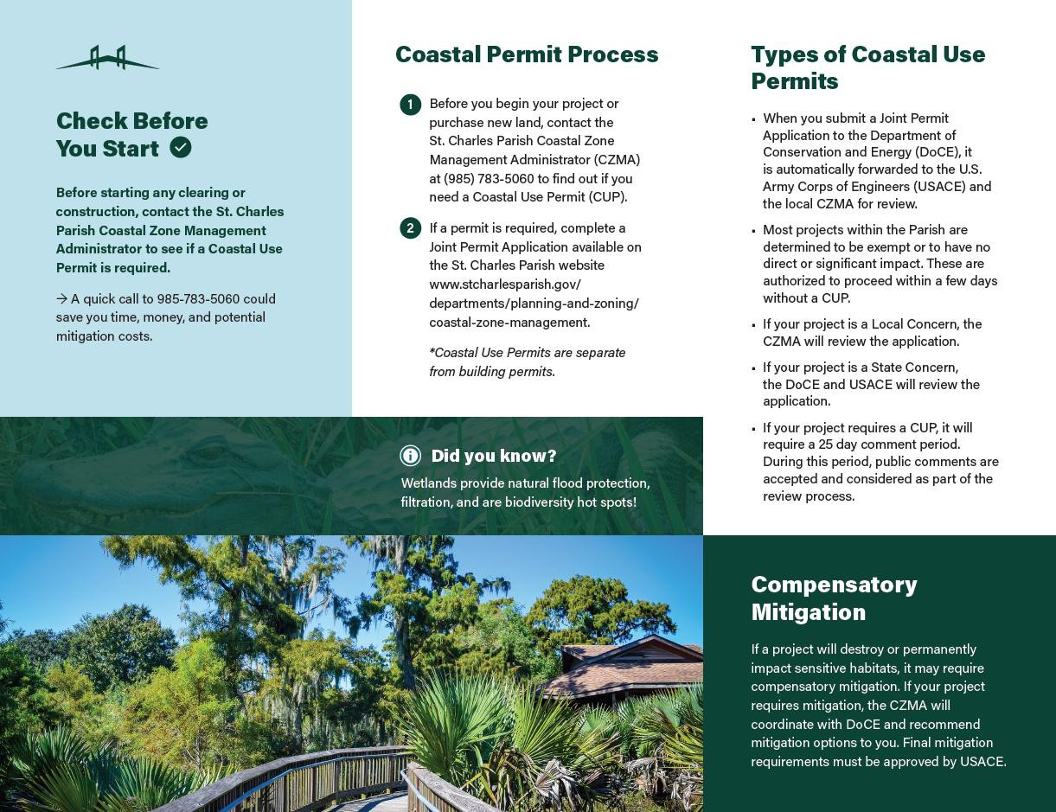
Coastal Zone
Edits to Chapter 25 of the code to ensure internal consistency.
Re-establishment of the Local Coastal Zone Advisory Committee and engagement of their public oversight.
  Monthly meetings, information sessions, and coordination with State agencies.
Development of the Coastal Use Permits in SCP “Do I Need One?” document.
Internal processes to ensure that Coastal considerations are presented and accounted for at step one of the development process.

Slide 13

Dependable, Resilient, and Ready
The Department of Planning and Zoning continues to follow through on its mission of protecting community safety and standards.
Our staff is qualified and accredited per their responsibilities and we promote from
within whenever possible. provides dependable service
The team on a wide
array of needs and responsibilities.
The Department is always looking to improve and respond to changing needs of the residents.

